Slide 1
EE2019 network creation and analysis
Data Analytics 2018-2019
Antonio Briola, 806906
Università degli Studi di Milano-Bicocca

Slide 2


Table of contents
Introduction
Data retrieving
EE2019 network
EE2019 network analysis (Centrality Measures)
Sentiment analysis
Community detection
Conclusions and future work

Slide 3
Introduction
26th May 2019 represented a crucial date for Europe. It was the last day of the week devoted to European Elections 2019 (in the next, EE2019). In an apparently clime of growing discontent and desire for radical renewal, results, however, gave reason to moderate forces.
Main goals of the current work are:
retrieve and treat a consistent corpus of tweets regarding EE2019
reconstruct users’ underlying network relying on mentions’ relationships
execute a task of lexicon based sentiment analysis both on the whole network and on underlying greatest communities.

Slide 4
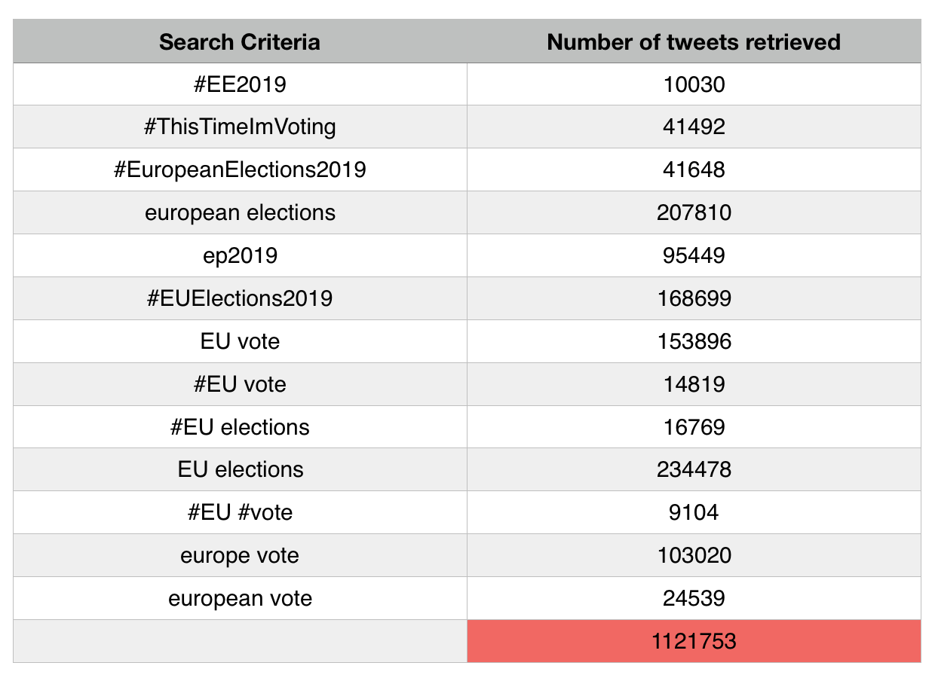
Data retrieving
Total number of tweets equal to 999448.
Each tweet is re-tweeted, in average, ∼ 4.38 times.
Each tweet is liked (favourites) in average, ∼ 10.70 times.
Each tweet receives, in average, ∼ 1.19 replies.
Each tweet has an average length equal to 192.68 chars.
Each tweet has an average number of ∼ 1.5 hashtags.
Each tweet contains, in average, ∼ 0.45 mentions.
Employed keywords during the phase of data retrieving.

Slide 5
EE2019 network - Creation
EE2019 network was built considering only documents referring to the last month before elections (from 26/04/2019, to 26/05/2019).
Each node of the graph has three attributes: username, text, language.
The username of the author of each tweet written in the fixed period is considered.
If it is not a node of EE2019 network it is added to the network as a new node.
Otherwise just the text of the tweets is added to the one already existing of the relative node.
If the tweet contains mentions, a list of them is created. Each mentioned profile is considered.
If it is already a node of the graph it is not added to the network.
Otherwise it is added to the network leaving text and language fields blank.

Slide 6
EE2019 network – Preliminary Analysis
Type of network: directed
Total number of nodes: 177349
Total number of edges: 122664
Isolated nodes: 130961
Density: 0.000004
Average clustering coefficient: 0.01353
Average path length: 8.34

Slide 7
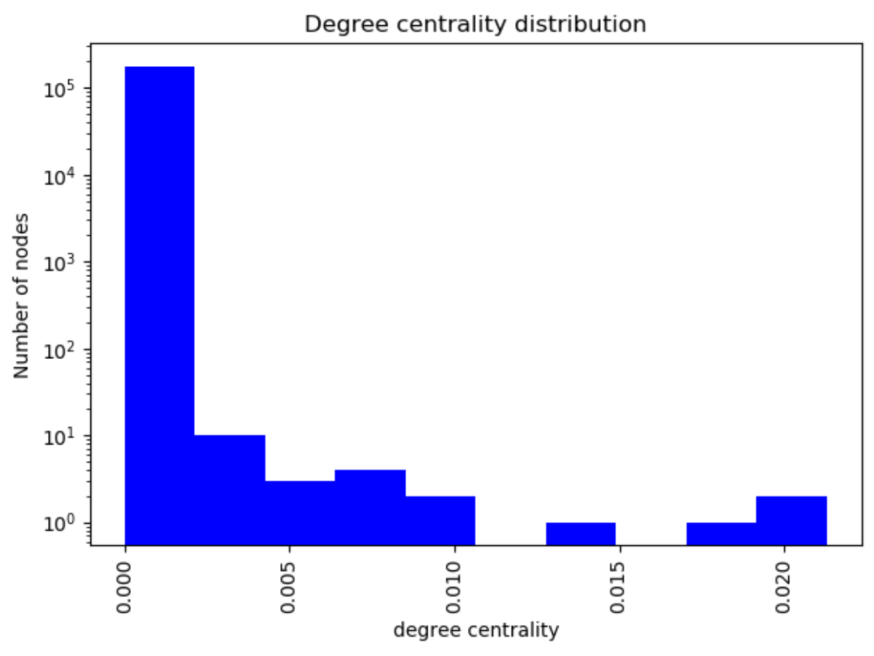
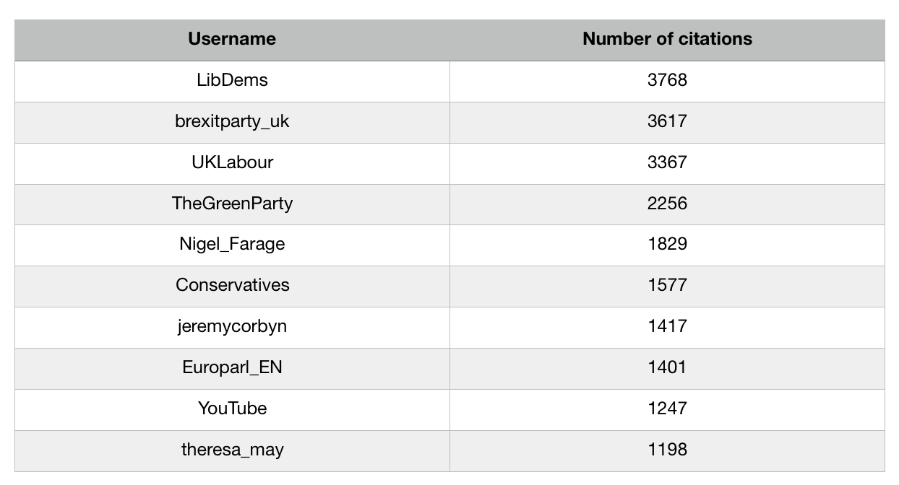
EE2019 network – Degree distribution
Degree centrality distribution
Nodes with the highest in-degree.

Slide 8
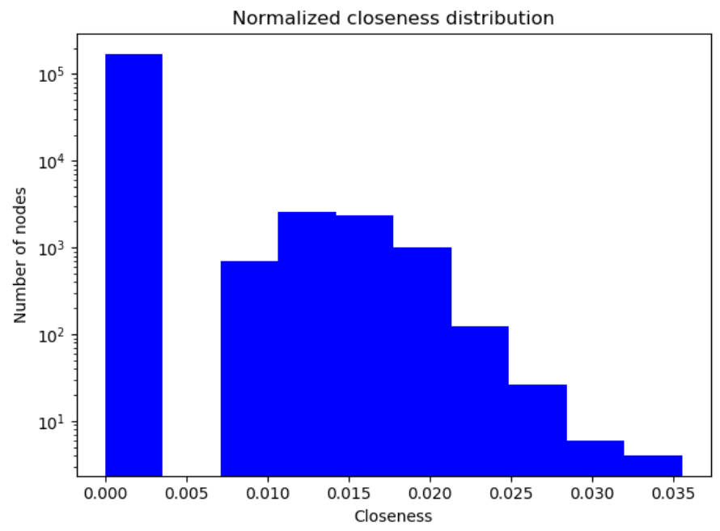
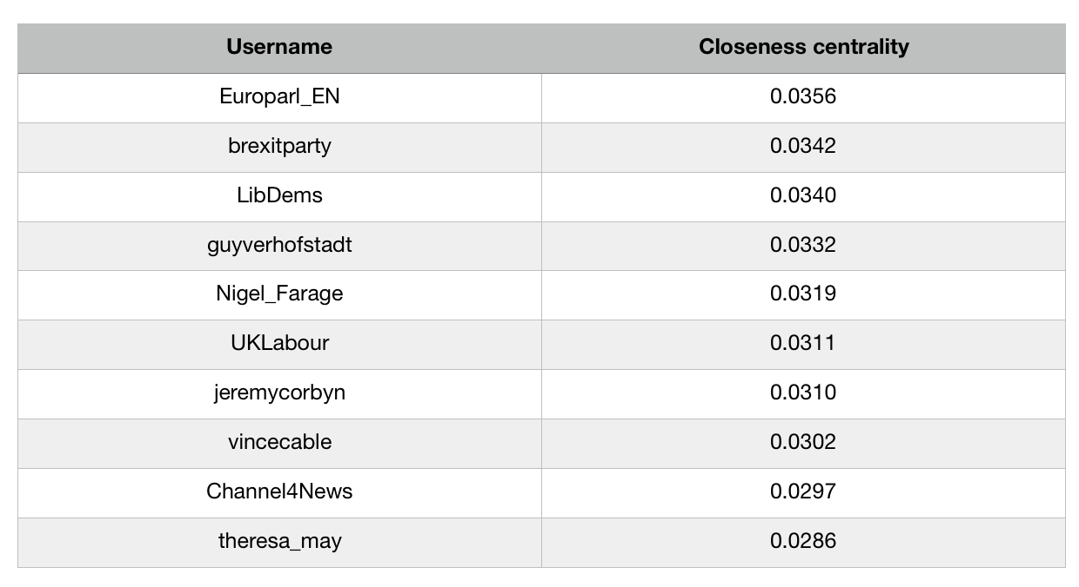
EE2019 network – Closeness Centrality
Closeness centrality distribution
Nodes with the highest Closeness centrality.

Slide 9
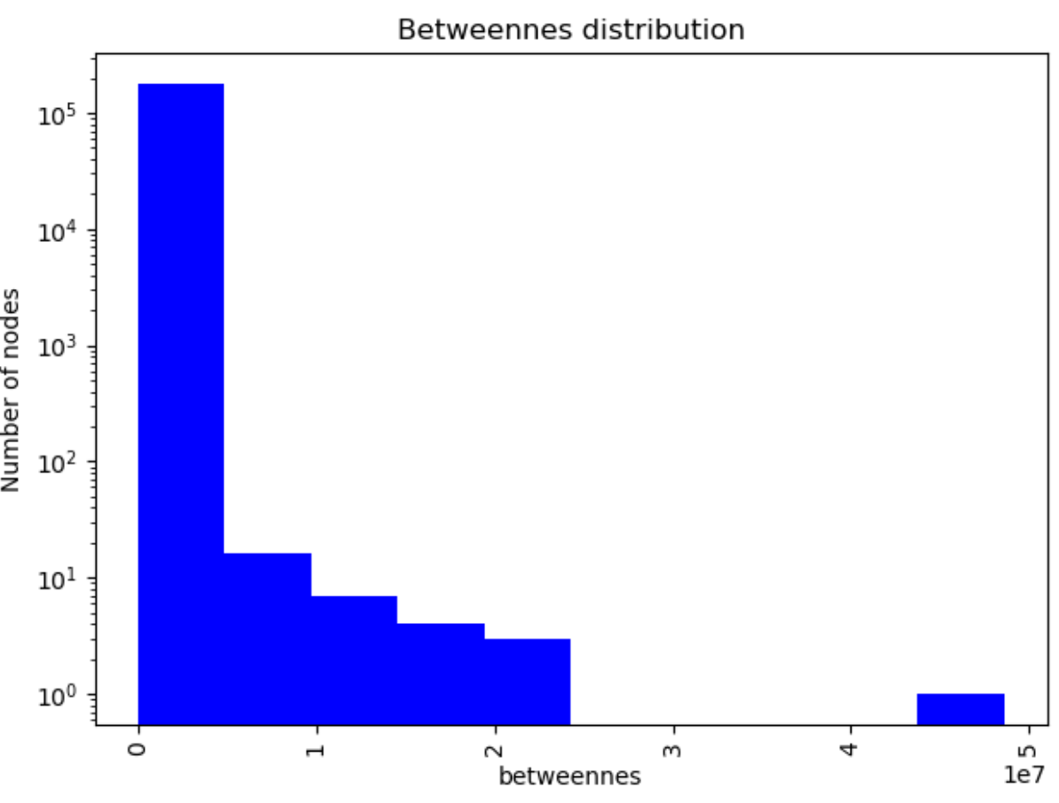
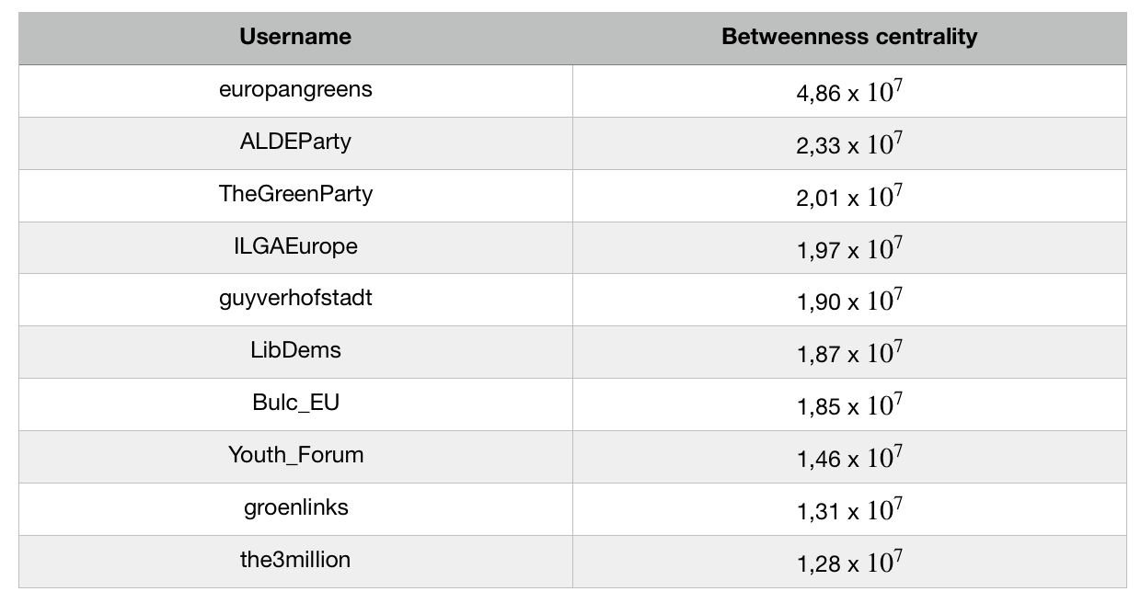
EE2019 network – Betweenness Centrality
Betweenness centrality distribution
Nodes with the highest Betweenness centrality.

Slide 10
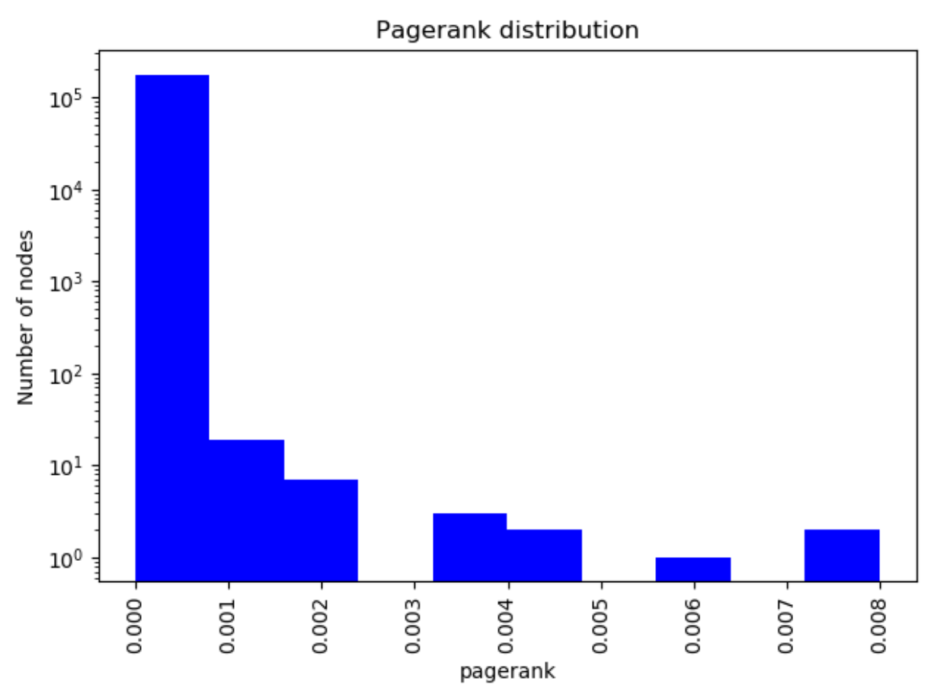
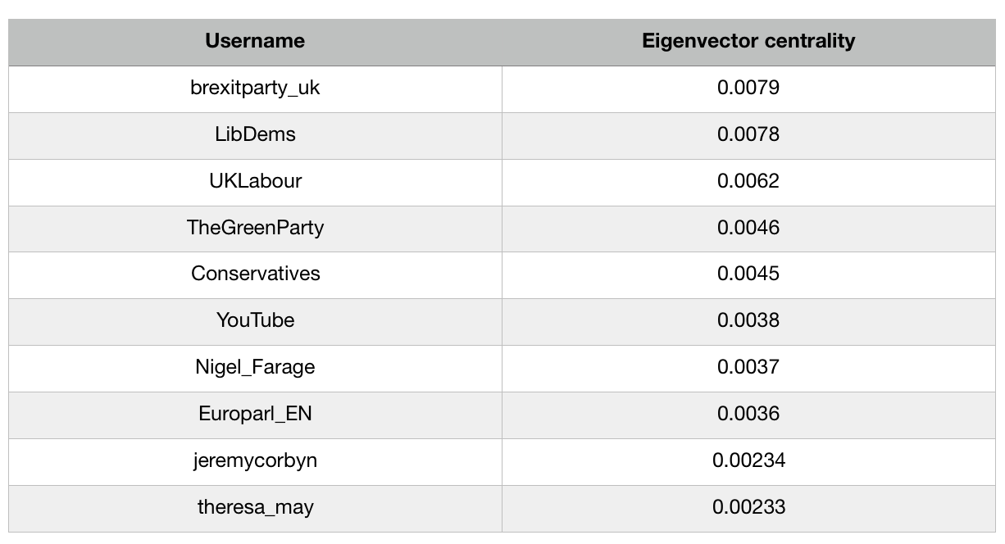
EE2019 network – PageRank Centrality (1)
PageRank centrality distribution
Nodes with the highest PageRank centrality.

Slide 11
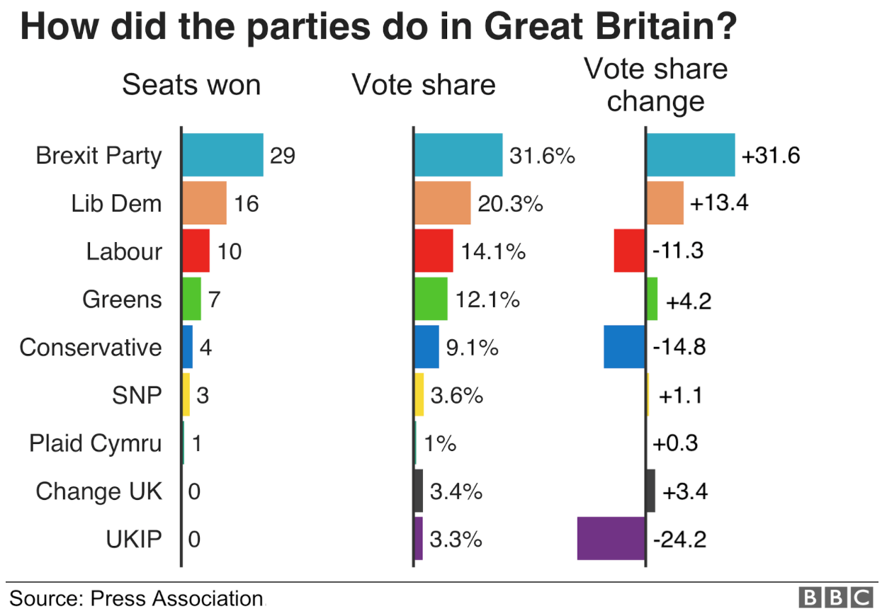
EE2019 network – PageRank Centrality (2)
EE2019 elections’ results in UK.
Nodes with the highest PageRank centrality.

Slide 12
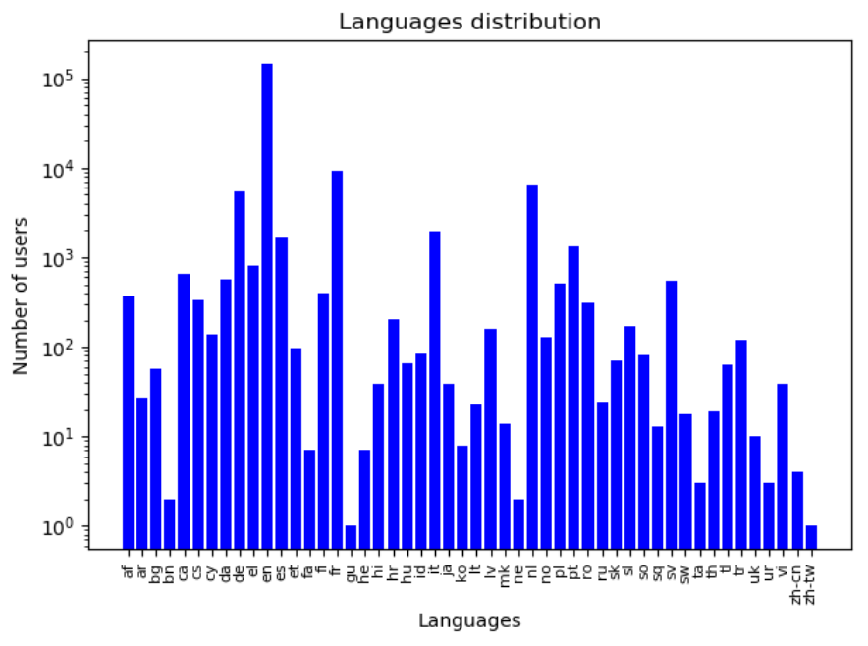
EE2019 network – LB Sentiment Analysis (1)
Tweets’ language distribution.

Slide 13
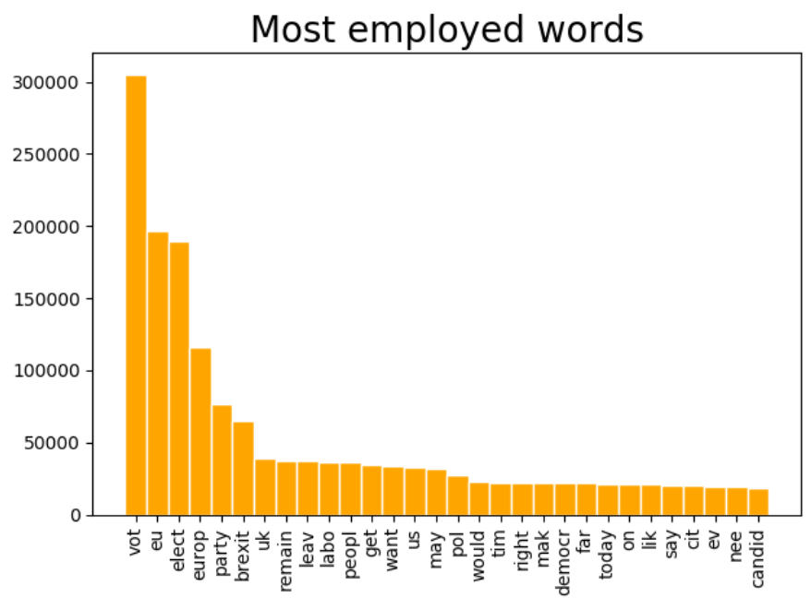
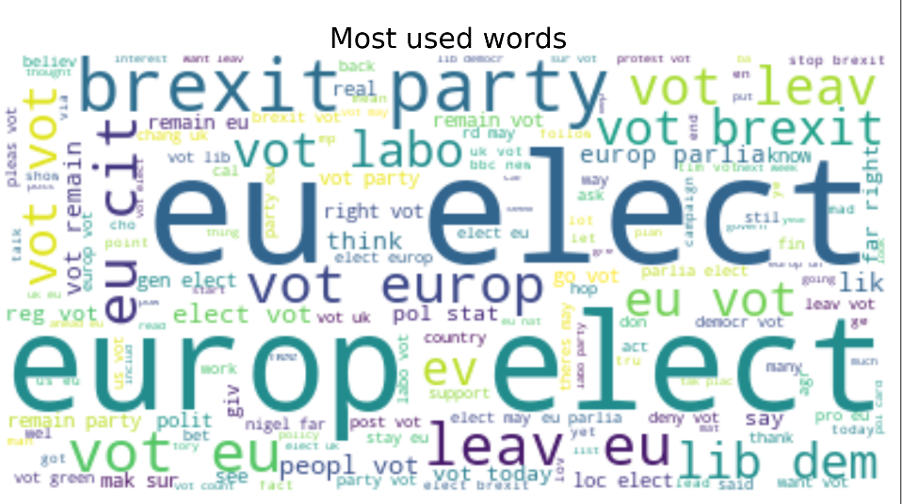
EE2019 network – LB Sentiment Analysis (2)
EE2019 network’s Word Cloud
Thirty English most used words.

Slide 14
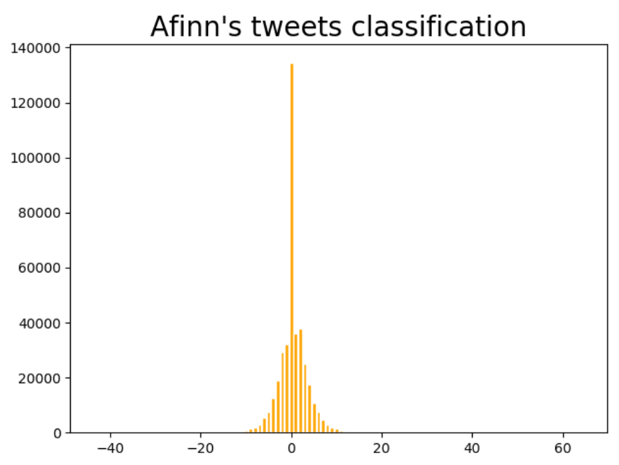
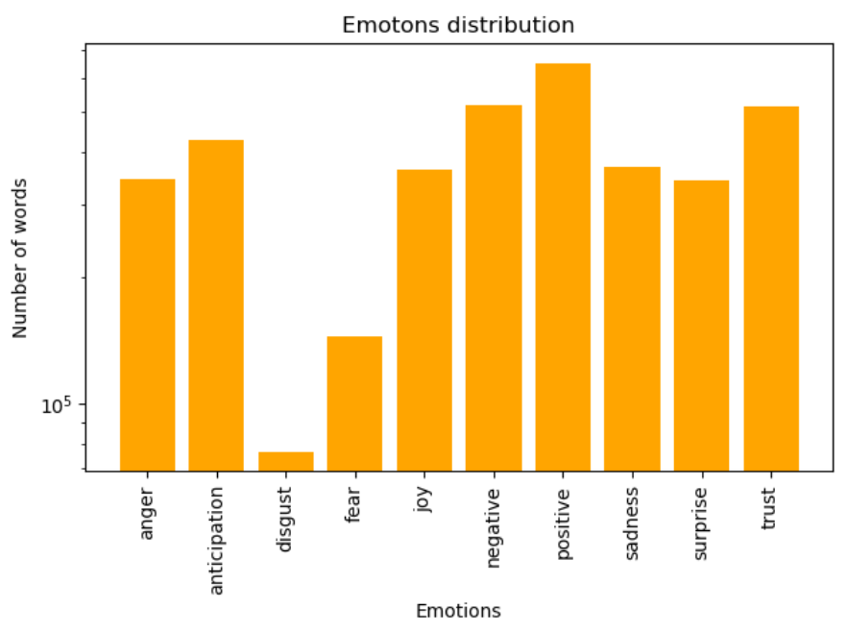
EE2019 network – LB Sentiment Analysis (3)
Afinn’s Lexicon based sentiment analysis.
NRC’s Lexicon based sentiment analysis.

Slide 15
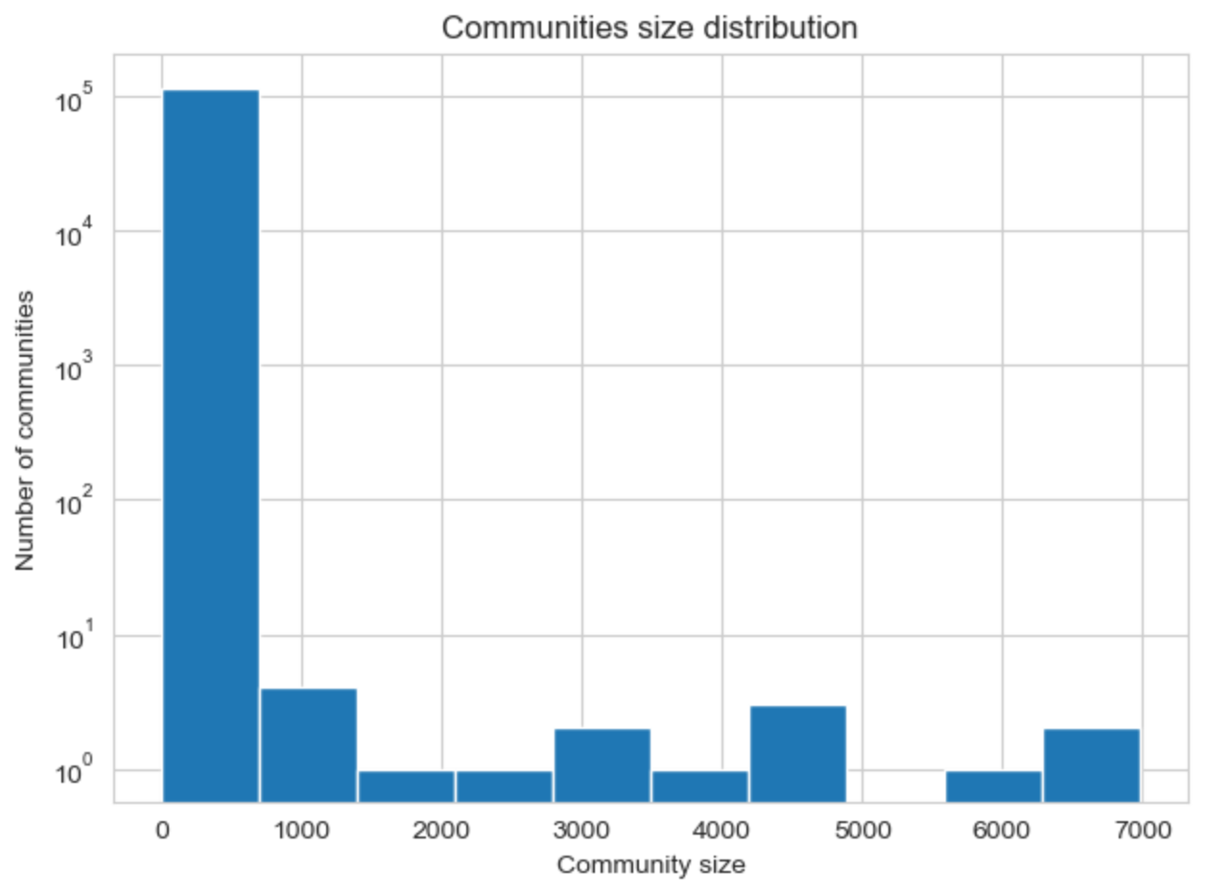
Community detection
Employed Python module: Networkit
Employed algorithm: PLM (Parallel Louvain Method)
Number of communities detected: 114658
Minimum size: 1
Maximum size: 6974
Average community size: 1,547
Average modularity: 0,724
Communities size distribution.

Slide 16

Community detection – First Largest Community (1)
Number of nodes: 6974
Number of edges: 11913
Node with maximum degree: LibDems
Average degree: 3,41
Density: 0,000488
LibDems logo.

Slide 17
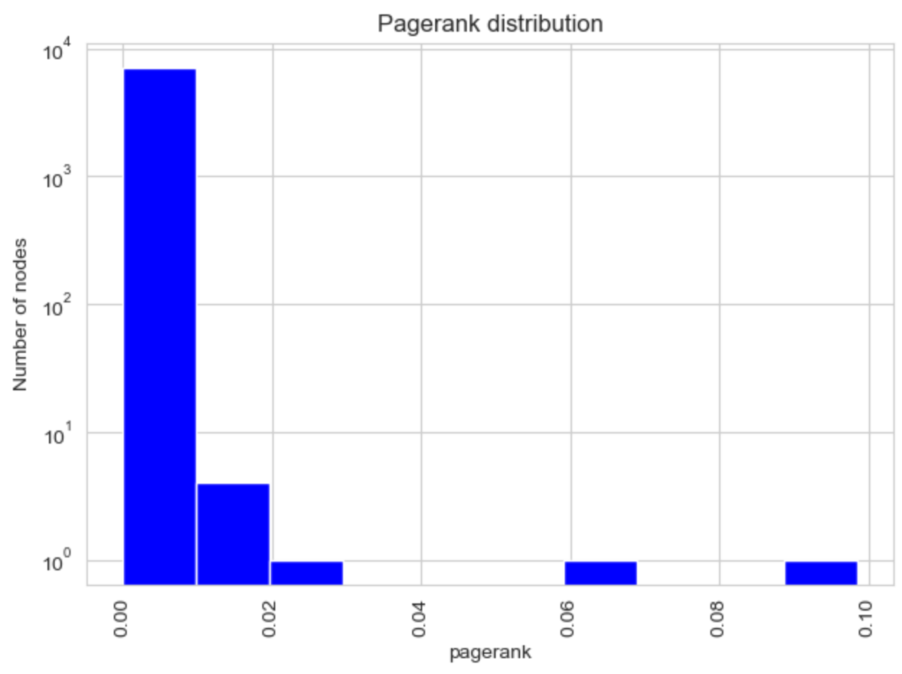
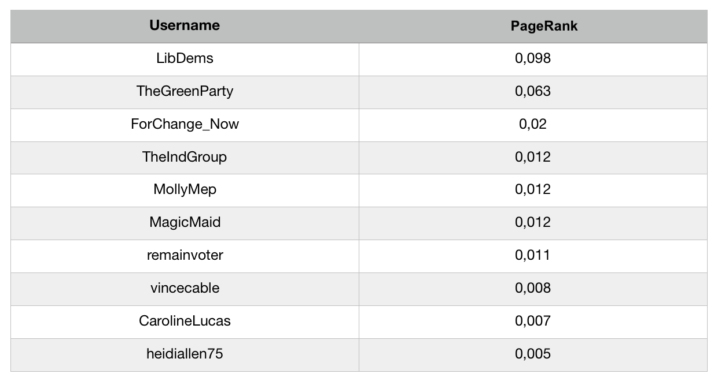
Community detection – First Largest Community (2)
PageRank centrality distribution
Nodes with the highest PageRank centrality.

Slide 18
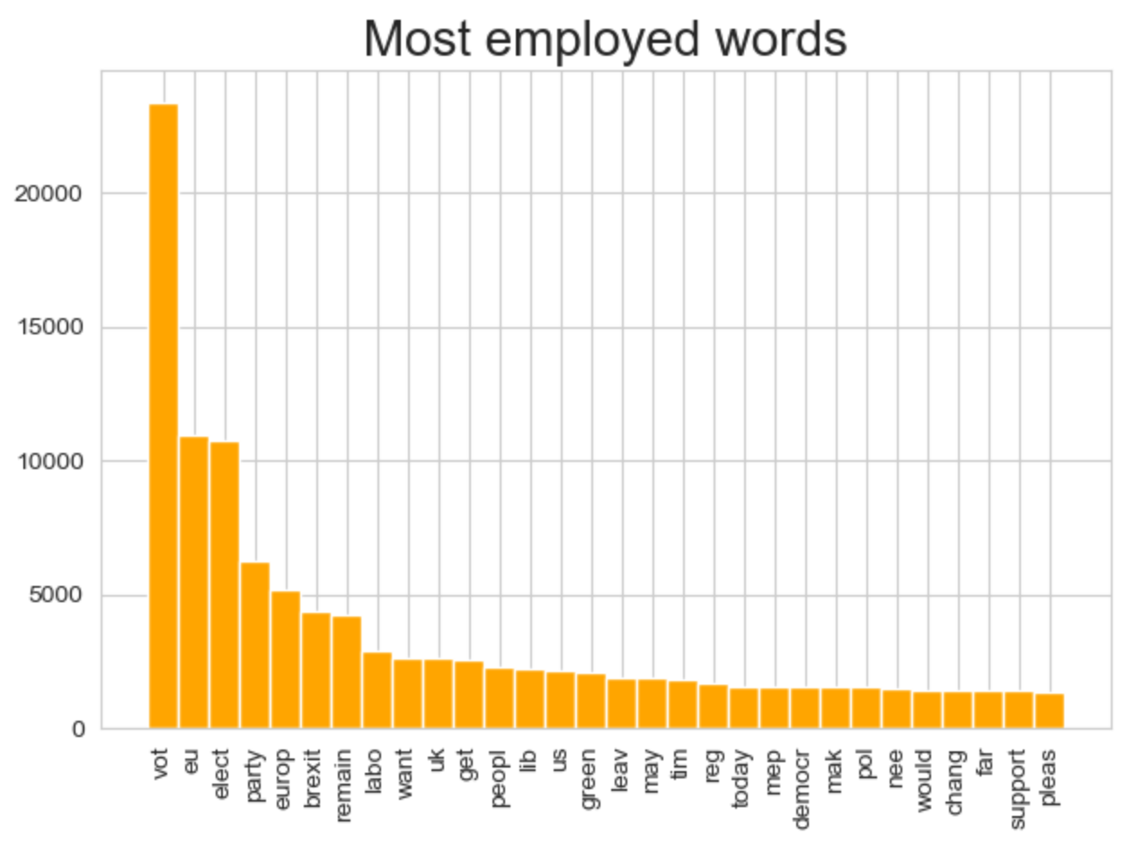
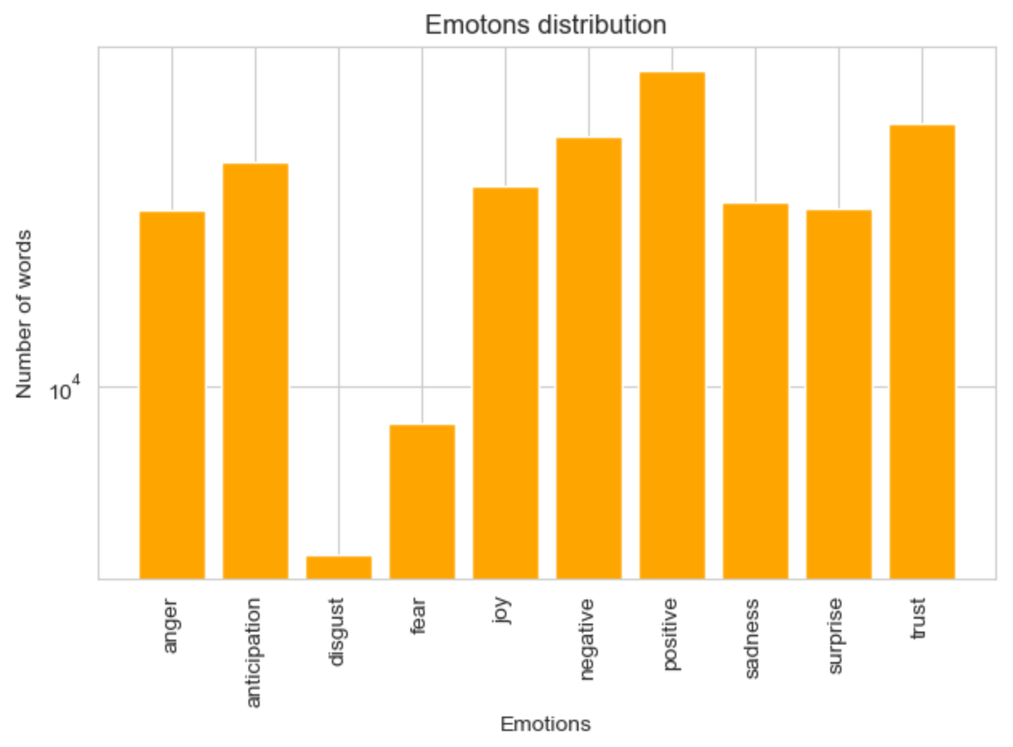
Community detection – First Largest Community (3)
Thirty English most used words.
NRC’s Lexicon based sentiment analysis.

Slide 19

Community detection – Second Largest Community (1)
Number of nodes: 6904
Number of edges: 10997
Node with maximum degree: brexitparty_uk
Average degree: 3,18
Density: 0,000461
brexitparty_uk logo.

Slide 20
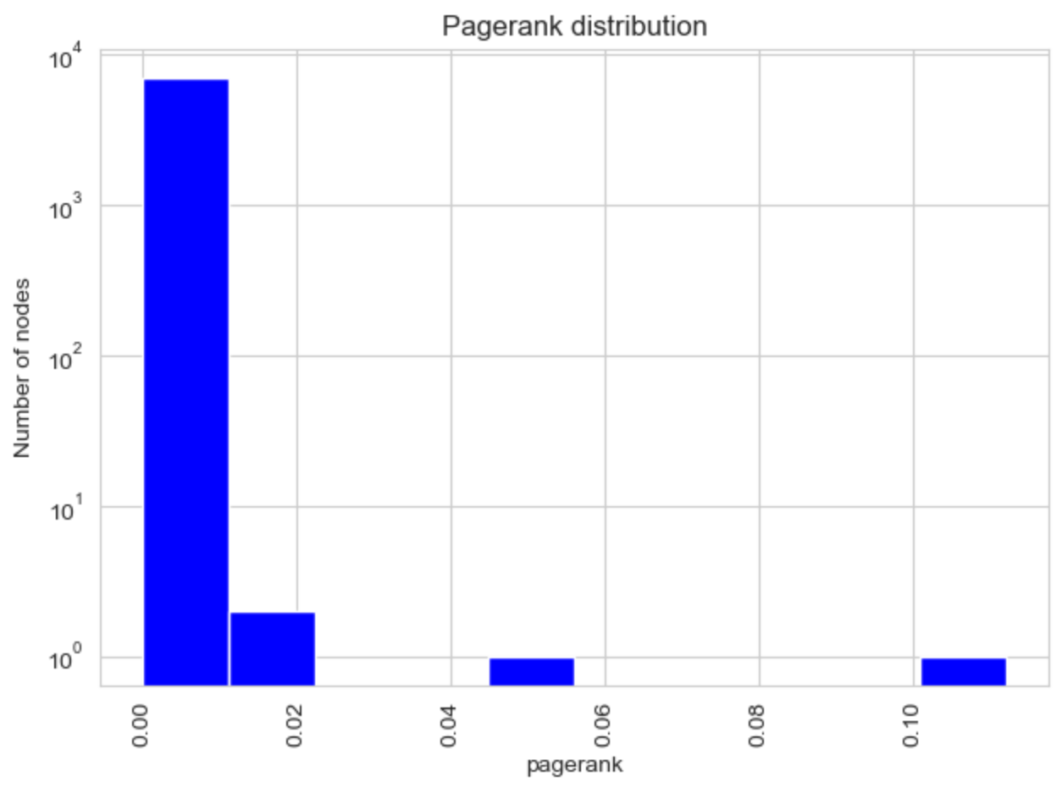
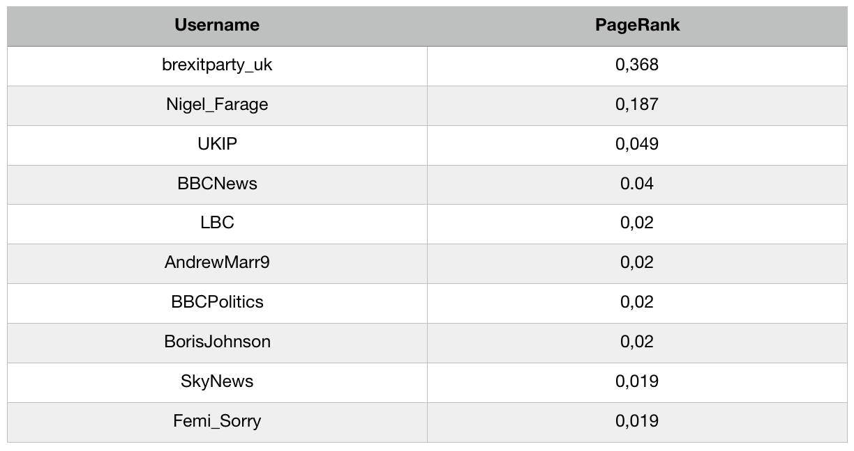
Community detection – Second Largest Community (2)
PageRank centrality distribution
Nodes with the highest PageRank centrality.

Slide 21
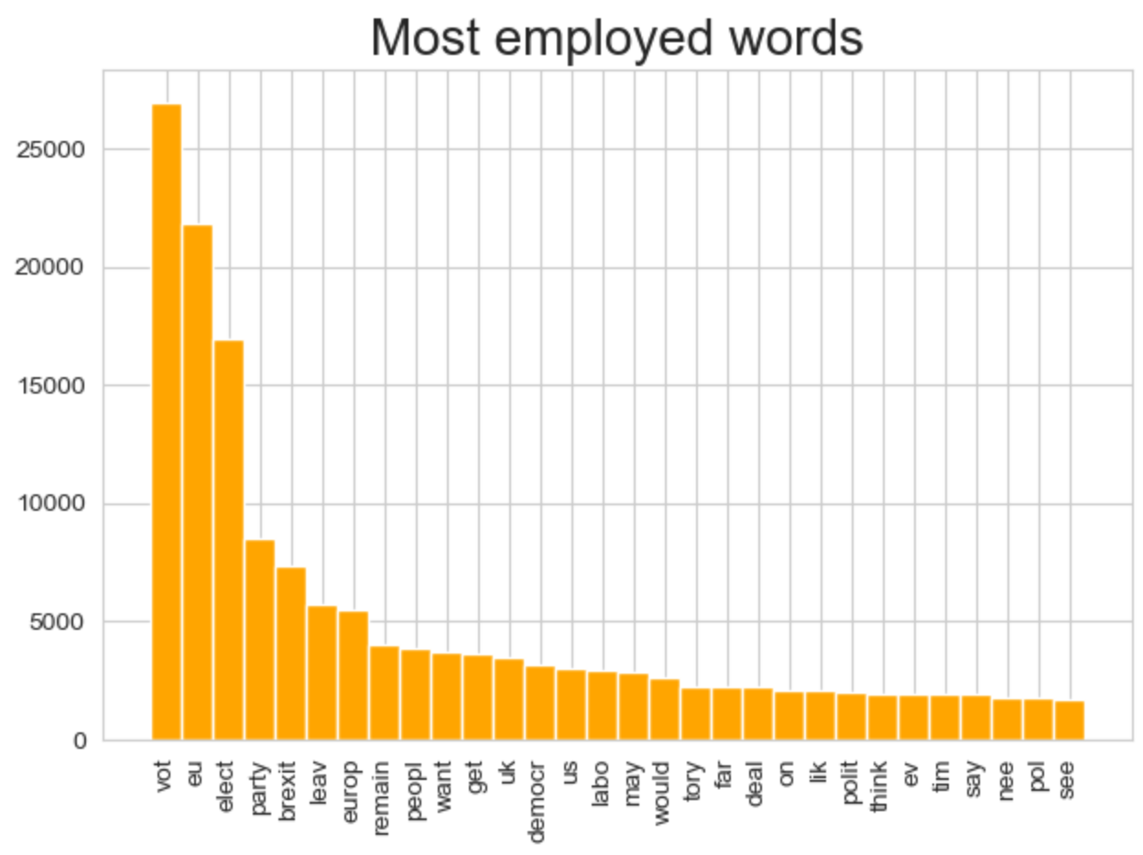
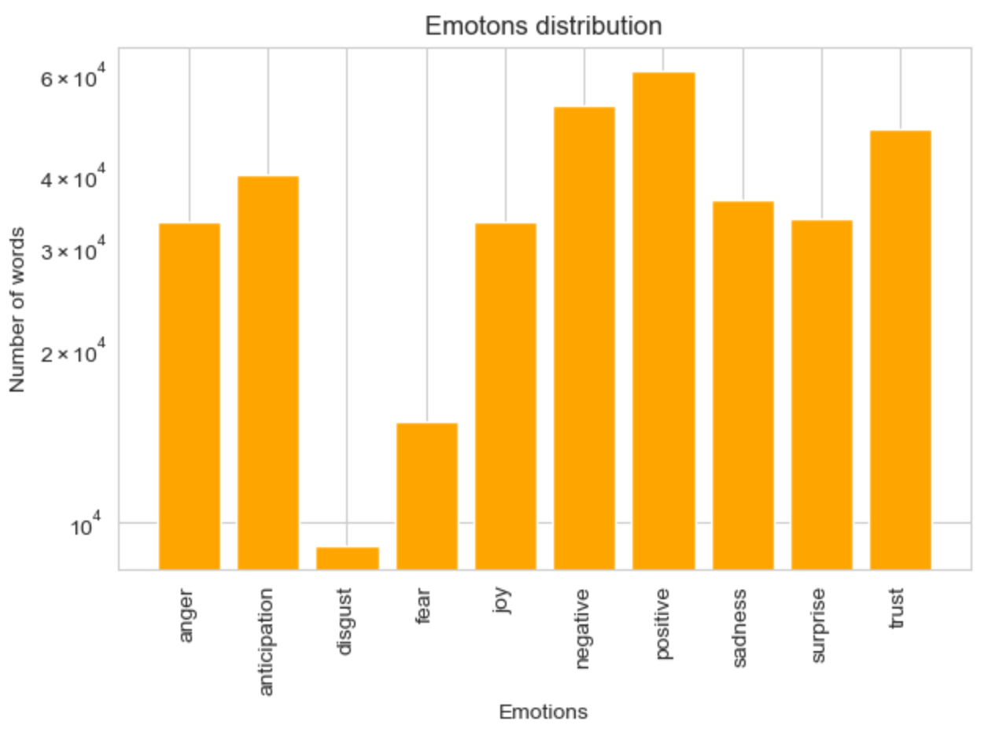
Community detection – Second Largest Community (3)
Thirty English most used words.
NRC’s Lexicon based sentiment analysis.

Slide 22

Community detection – Third Largest Community (1)
Number of nodes: 6041
Number of edges: 10086
Node with maximum degree: UKLabour
Average degree: 3,334
Density: 0,000551
UKLabour logo.

Slide 23
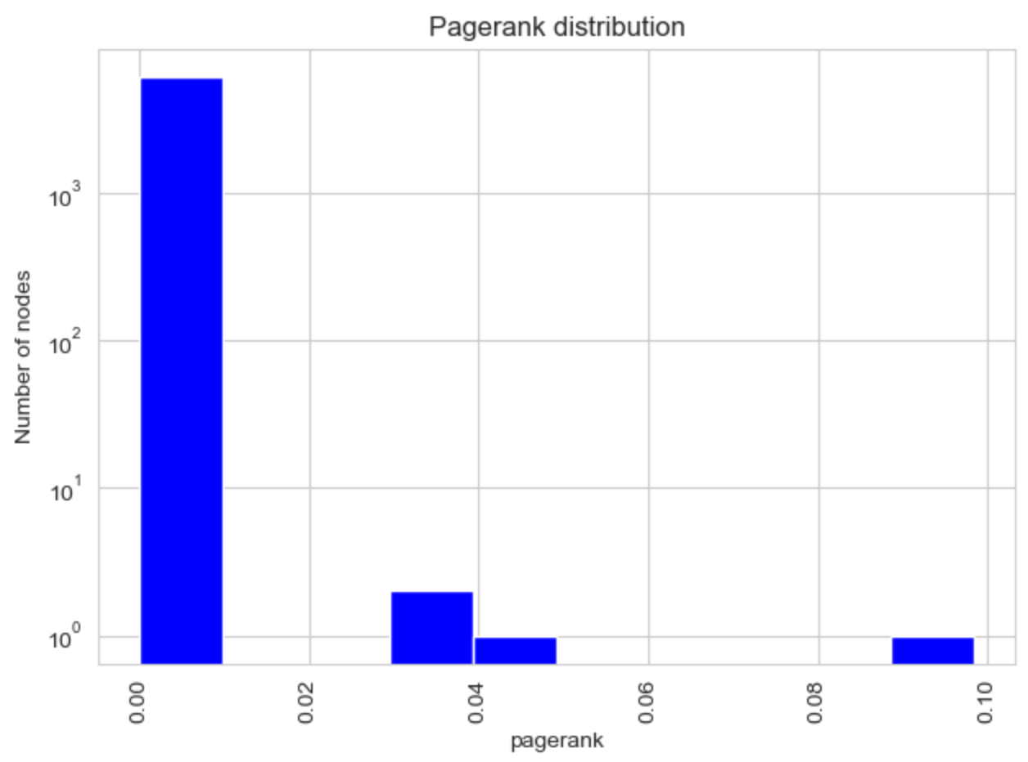
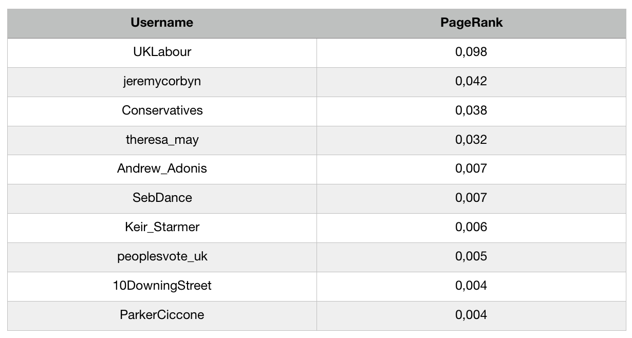
Community detection – Third Largest Community (2)
PageRank centrality distribution
Nodes with the highest PageRank centrality.

Slide 24
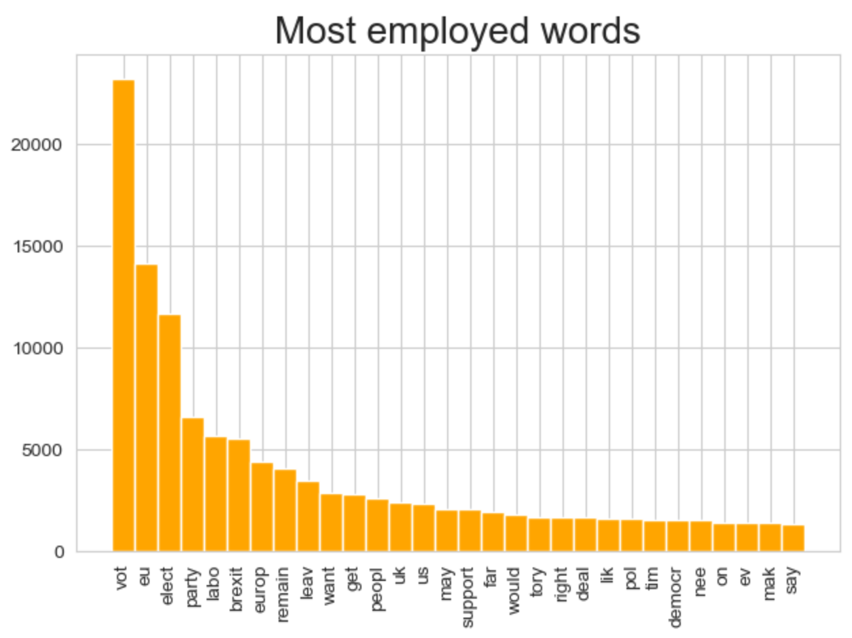
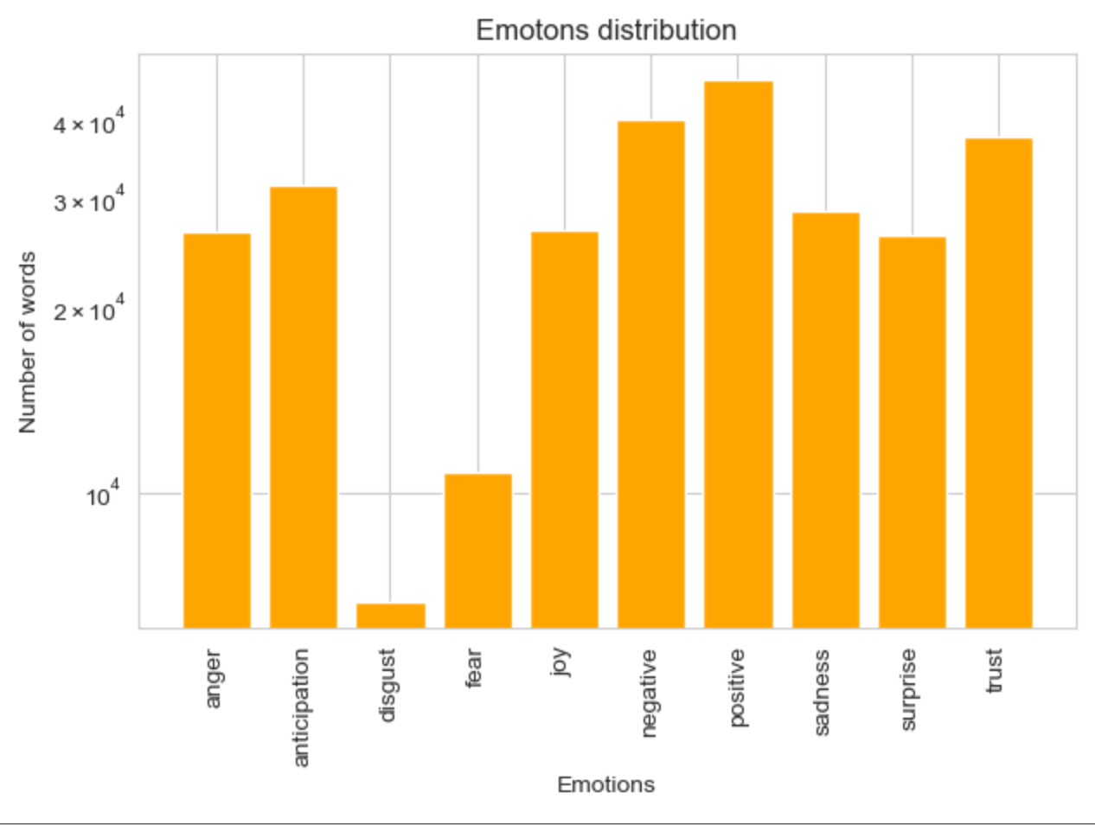
Community detection – Third Largest Community (3)
Thirty English most used words.
NRC’s Lexicon based sentiment analysis.

Slide 25
Conclusions
Mention based network creation process revealed to be well representative for the common feeling around European Elections 2019.
Analysis about EE2019 network was affected by a bias depending on the language. Great emphasis was given to results registered in UK but they revealed to be well representative for the general European situation.
Sentiment analysis about tweets published in the last month before elections gave a faithful anticipation of global results.
Sentiment analysis revealed a usage of a moderate lexicon which, however, didn’t hide users’ vote intentions.

Slide 26
Thank you for your attention.

